Slide 1


Santosh Kumar Kar,
skkar.2k2@gmail.com

Slide 2
CHAPTER – 4
Spring and Hibernate
Santosh Kumar Kar
skkar.2k2@gmail.com

Slide 3
Introduction
Spring comes with a family of data access frameworks that integrate with a variety of data access technologies. You may use direct JDBC, iBATIS, or an object relational mapping (ORM) framework like Hibernate to persist your data. Spring supports all of these persistence mechanisms.

Slide 4
Recall Hibernate
Hibernate is an open source project whose purpose is to make it easy to integrate relational data into Java programs. This is done through the use of XML mapping files, which associate Java classes with database tables.
Hibernate provides basic mapping capabilities. It also includes several other object/relational mapping (ORM) capabilities, including:
An enhanced, object-based SQL variant for retrieving data, known as Hibernate Query Language (HQL).
Automated processes to synchronize objects with their database equivalents.
Built-in database connection pooling, including three open-source variants.
Transactional capabilities that can work both stand-alone or with existing Java Transaction API (JTA) implementations.
The goal of Hibernate is to allow object-oriented developers to incorporate persistence into their programs with a minimum of effort.

Slide 5
Why to Integrate Hibernate with Spring
Spring Integrates very well with Hibernate. If someone asks why do we need to integrate hibernate in Spring? Yes, there are benefits.
The very first benefit is the Spring framework itself. The IoC container makes configuring data sources, transaction managers, and DAOs easy.
It manages the Hibernate SessionFactory as a singleton – a small but surprisingly annoying task that must be implemented manually when using Hibernate alone.
It offers a transaction system of its own, which is aspectoriented and thus configurable, either through Spring AOP or Java-5 annotations. Either of these are generally much easier than working with Hibernate’s transaction API.
Transaction management becomes nearly invisible for many applications, and where it’s visible, it’s still pretty easy.
You integrate more easily with other standards and frameworks.

Slide 6
Integrating Hibernate with Spring
A typical Hibernate application uses the Hibernate Libraries, configures its SessionFactory using a properties file or an XML file, use hibernate session etc. Now let’s discuss the steps we must follow while integrating Hibernate with Spring.
Step 1: Set Hibernate Libraries in classpath.
Step 2: Declare a bean in Spring Config file for Hibernate Session Factory.
Step 3: Inject session factory into Hibernate template.
Step 4: Inject hibernate template into DAO classes.
Step 5: Define the property HibernateTemplate in each DAO classes.
Step 6: Use hibernate Queries through Hibernate Template object in DAO.
Let’s discuss all these steps one by one.

Slide 7
Step 1: Adding Hibernate Libraries
To integrate Hibernate with Spring, you need the hibernate libraries along with Spring.
So the first step should be downloading all the necessary library jars for Hibernate and set those jars into the project classpath just like you already have set the Spring libraries..

Slide 8
Step 2: Configure for Hibernate Session Factory
A typical Hibernate application uses the Hibernate Libraries, configures its SessionFactory using a properties file or an XML file, use hibernate session etc. Now let’s discuss the steps we must follow while integrating Hibernate with Spring.
A typical Hibernate application configures its SessionFactory using a properties file or an XML file.
First, we start treating that session factory as a Spring bean.
Declare it as a Spring <bean> and instantiate it using a Spring ApplicationContext.
Configure it using Spring <property>s, and this removes the need for a hibernate.cfg.xml or hibernate.properties file.
Spring dependency injection – and possibly autowiring – make short work of this sort of configuration task.
Hibernate object/relational mapping files are included as usual.

Slide 9
Hbm.xml
In our example, we do use 2 .hbm files: Employee.hbm.xml & Department.hbm.xml
The databse is MySql and using the driver based datasource in Spring.
Remember, here the session factory class used is : LocalSessionFactoryBean.

Slide 10
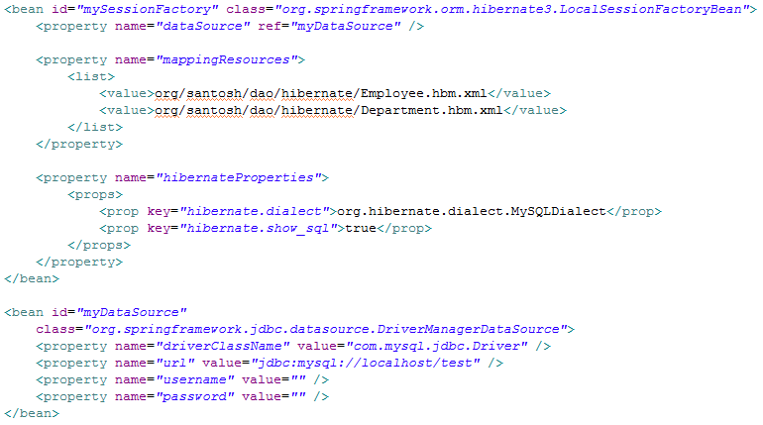

Datasource is injected into SessionFactory
All hbm files must be mapped here...
Hibernate.dialect -> declare dialect types according to your database.
We are not discussing more on different datasource types. You can visit our Spring part-2 section to know more on declaring datasources.

Slide 11
In step 1, we declared the session factory.
In step 2 here, we are injecting that session factory into Hibernate Template.
The hibernate template class is: org.springframework.orm.hibernate3.HibernateTemplate

Slide 12
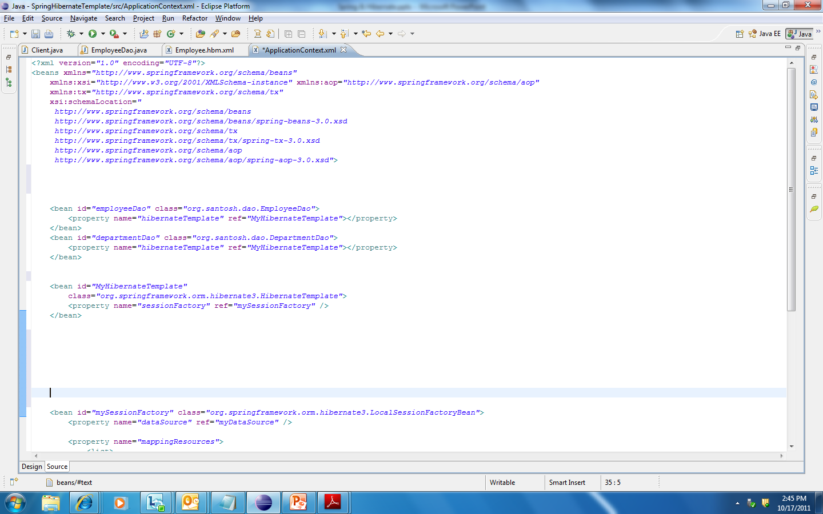
Step 3: Inject session factory into Hibernate template.
Step 4: Inject hibernate template into DAO classes.
Observe, we have declared the bean MyHibernateTemplate in Step 3.
MyHibernateTemplate is now injected into the DAO classes such as org.santosh.dao.EmployeeDao and org.santosh.dao.DepartmentDao.

Slide 13
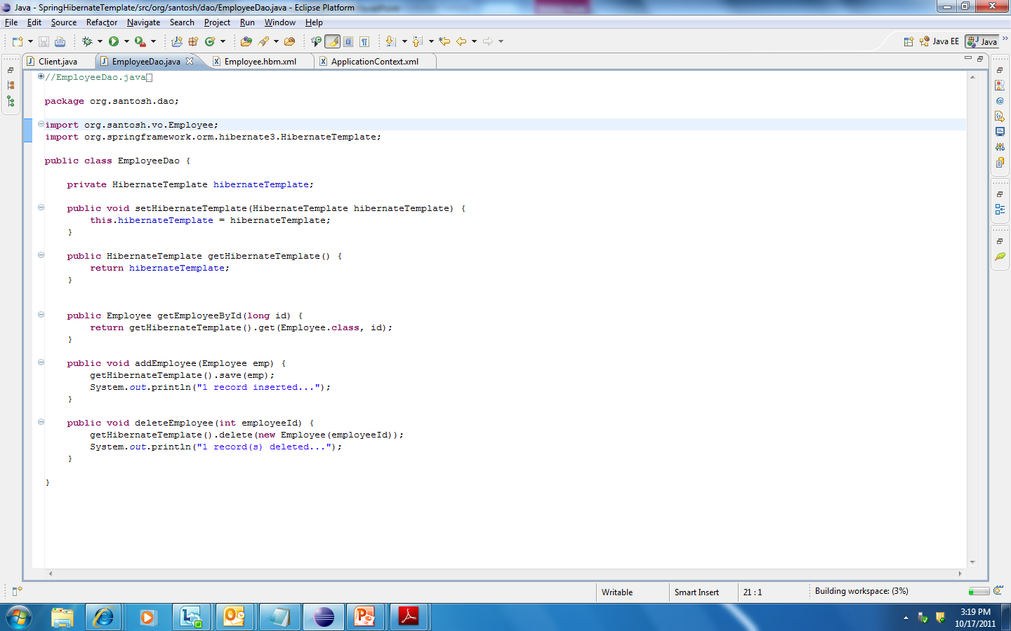

Step 5: Define the property HibernateTemplate in each DAO classes
One of the responsibilities of HibernateTemplate is to manage Hibernate Sessions. This involves opening and closing sessions as well as ensuring one session per transaction. Without HibernateTemplate, you’d have no choice but to clutter your DAOs with boilerplate session management code.
Import the class org.springframework.orm.hibernate3.HibernateTemplate. The setter method is required as we inject the hibernateTemplate into the DAO class in step 4.

Slide 14

Step 6: Use hibernate Queries through Hibernate Template object in DAO.
In Hibernate we were using the methods such as session.get(…), session.load(…), session.save(…), session.saveOrUpdate(…), session.delete(…) etc. All such methods are now used using hibernatetemplate. For example we use getHibernateTemplate().get(Employee.class, id) which reattach the Employee object from DB.

Slide 15
HibernateDaoSupport
So far, the configuration of DAO class (e.g. EmployeeDao or DepartmentDao) involves four beans.
The data source is wired into the session factory bean through LocalSessionFactoryBean
The session factory bean is wired into the HibernateTemplate.
Finally, the HibernateTemplate is wired into DAO (e.g. EmployeeDao or DepartmentDao), where it is used to access the database.
To simplify things slightly, Spring offers HibernateDaoSupport, a convenience DAO support class, that enables you to wire a session factory bean directly into the DAO class. Under the covers, HibernateDaoSupport creates a HibernateTemplate that the DAO can use.

Slide 16
HibernateDaoSupport
Extend the class HibernateDaoSupport in each of the DAO class.
Remove the property HibernateTemplate as it is already provided in HibernateDaoSupport class.
The rest of the code will remain unchanged.
Now lets change the EmployeeDao class and implement the HibernateDaoSupport.

Slide 17
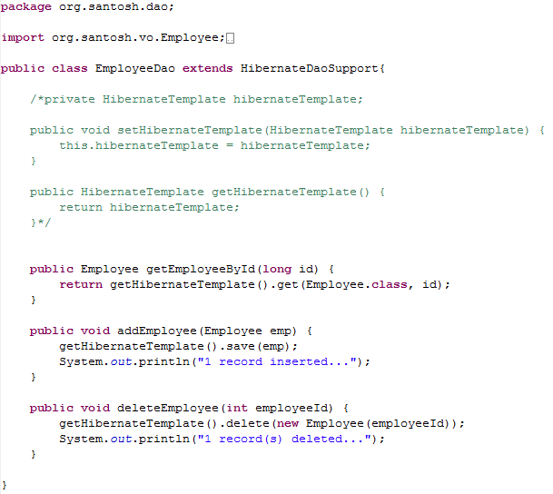
No changes in the spring configuration XML
Extended HibernateDaoSupport
Ignore and don’t use this in any of your DAO class because you extends HibernateDaoSupport and so this class had already done this for you.
Simply use the methods with getHibernateTemplate() method as you were using session.get(), session.load() etc. in hibernate

Slide 18
Using Hibernate 3 contextual sessions
As we saw that one of the responsibilities of HibernateTemplate is to manage Hibernate Sessions. This involves opening and closing sessions as well as ensuring one session per transaction.
But the HibernateTemplate is coupled to the Spring Framework. So some developers may find such Spring’s intrusion undesirable to use in the DAO class so instead of using the HibernateTemplate in DAO, they prefer to use the HibernateSession in that place.\
So Hibernate 3 provides the cotextual session where Hibernate manages one session per transaction so there is no need to use the Hibernte template. So use HibernateSession without coupling your DAO class fully with Spring.
To implement the contextual session in Hibernate 3, you need to inject sessionFactory in place of HibernateTemplate in Spring configuration file.

Slide 19
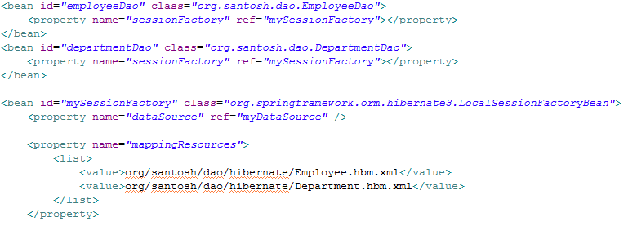
Using Hibernate 3 contextual sessions
No hibernateTemplate, uses SessionFactory

Slide 20
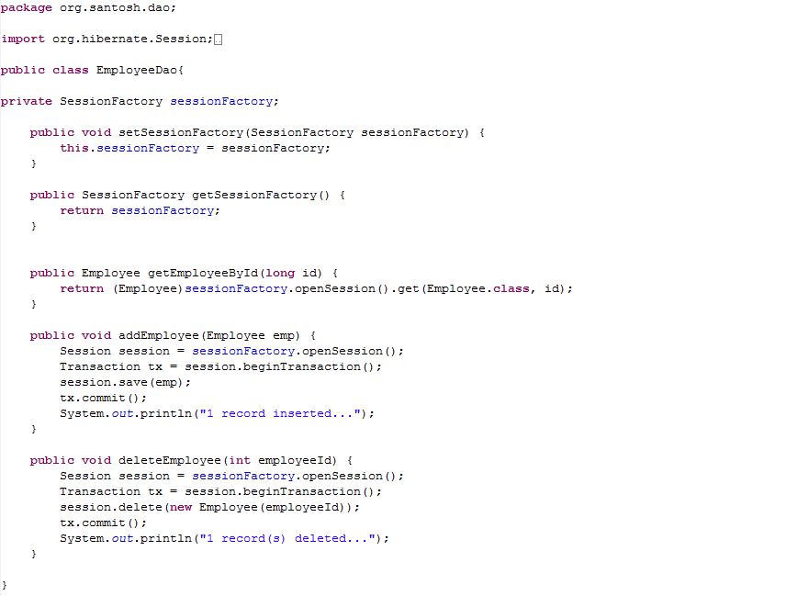
Writing DAO class
Injected SessionFactory (not HibernateTemplate)
Uses Hibernate session from SessionFactory

